Slide 1
Pretraining with Dictionaries

Slide 2
Motivation
Vocabulary is the basic element of a language. For a new language learner, he/she starts with memorizing elementary vocabularies and then applies to more complicated tasks.
Dictionary provides a weakly supervised dataset for all vocabularies with definition and synonym & antonym as labels. With the “labelled” data, pretraining is assumed to be much more efficient than MLM only.

Slide 3
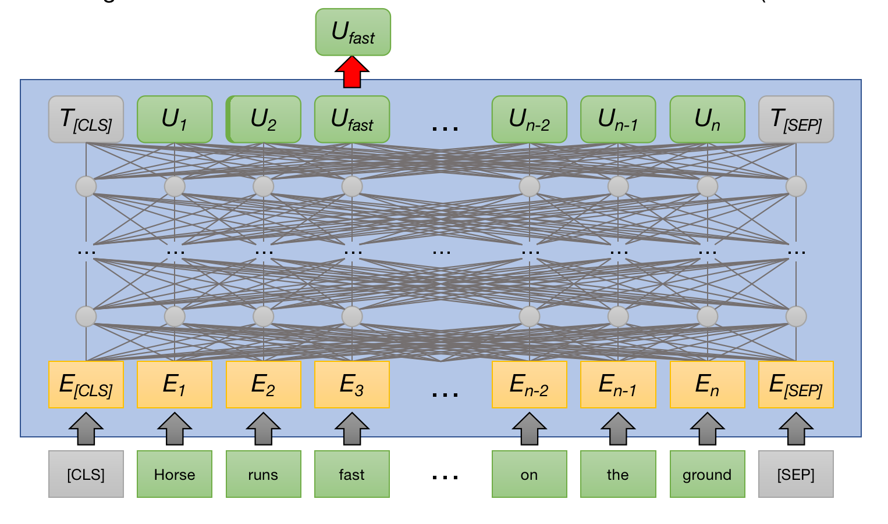
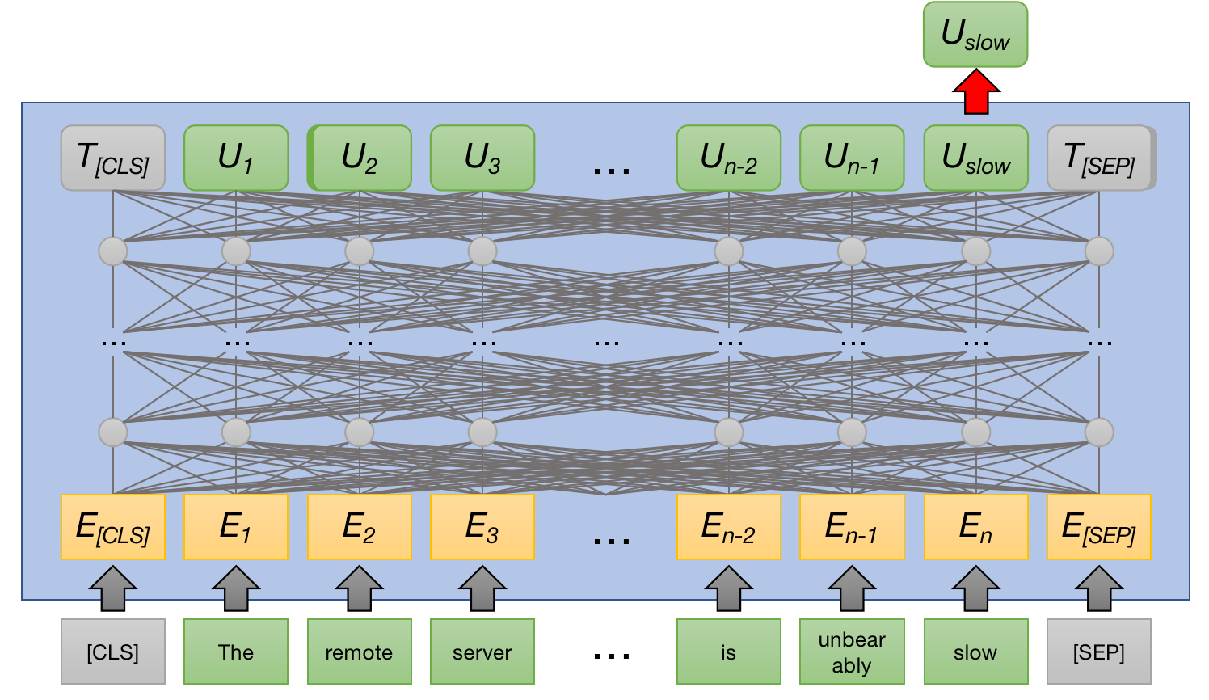
Pretraining Design
Contrastive Learning for antonym/synonym
a) label = contradiction
contrastive loss

Slide 4
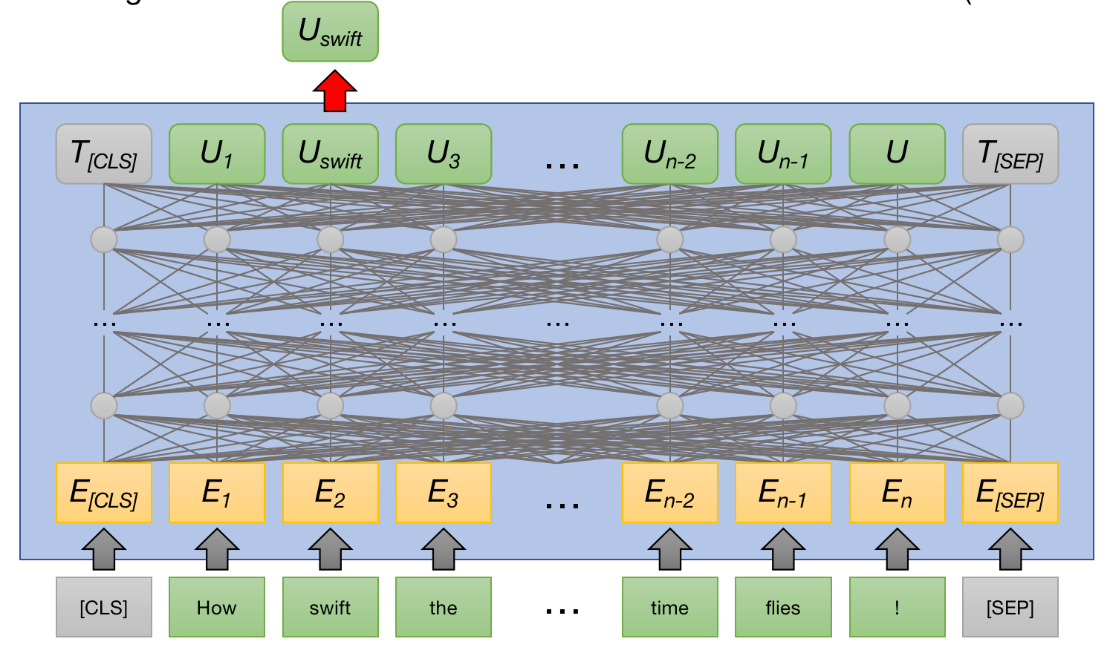
Pretraining Design
Contrastive Learning for antonym/synonym
b) label = entailment
there is a possible c) neutral where two words are not ant/syn.
contrastive loss

Slide 5
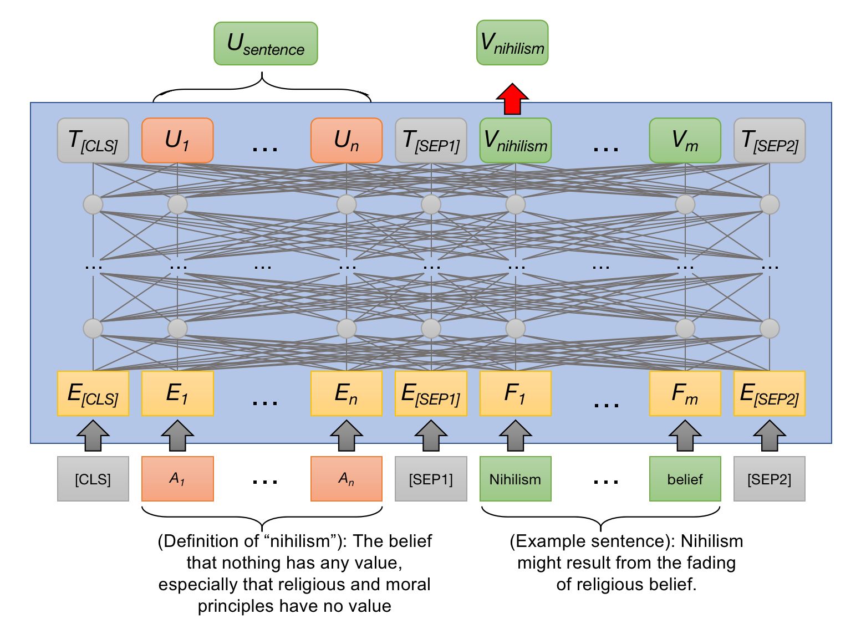
Pretraining Design
Contrastive Learning for definition
contrastive loss

Slide 6
Benefits
With contrastive learning task adding to MLM task, the pretraining process is expected to be accelerated because labeled data, which contains more information for word embedding, could be utilized.
It also benefits from the property of contrastive learning. Contrastive learning explicitly encourage alignment between similar pairs and uniformity between different pairs, resulting in better embedding distribution in latent space ( see the success of SimCSE for sentence embedding).
Finally, it helps the model to sufficiently learn rare words, which are hardly seen in general pretraining corpus.

Slide 7
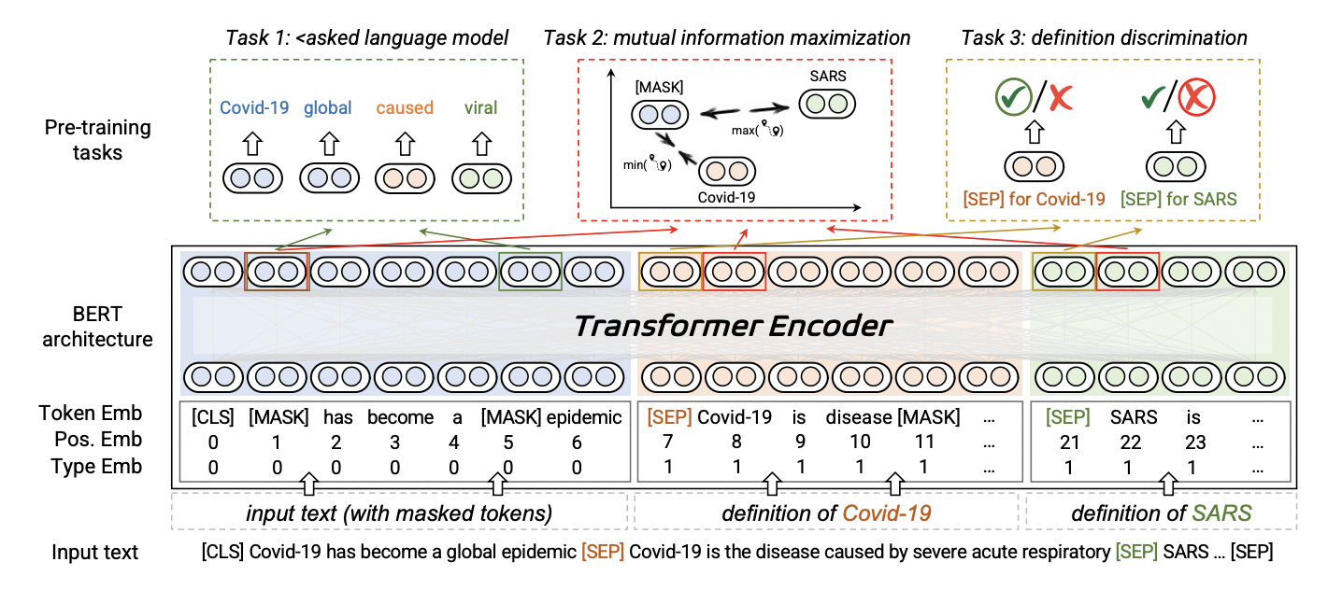
Related Work
A related work is Dict-BERT, which utilizes word Definition for solving rare word problem.
It directly pads defition to raw input sentence while pretraining.

